Slide 1
CS 4530 & CS 5500
Software Engineering
Lecture 9.3: Software Engineering & Security Threats
Jonathan Bell, John Boyland, Mitch Wand
Khoury College of Computer Sciences © 2021, released under CC BY-SA
Notes:
Hi, this is Professor Bell. In this lesson, we’ll begin to investigate security concerns in software engineering - starting with a discussion of security threats.

Slide 2
Learning Objectives for this Lesson
By the end of this lesson, you should be able to…
Describe that security is a spectrum, and be able to define a realistic threat model for a given system
Evaluate the tradeoffs between security and costs in software engineering

Slide 3
What does it mean for a system to be secure?
CIA: An overview of security properties
Confidentiality: is information disclosed to unauthorized individuals?
Integrity: is code or data tampered with?
Availability: is the system accessible and usable?
Notes:
Confidentiality - is information disclosed to unauthorized parties? This is not privacy, because the end-user doesn’t get to make a choice. Might make privacy a sub-requirement of confidentiality
Integrity - is our code or data tampered with, at rest, or in transit? usually more of a commercial interest. Someone downloads my customer database is not as bad to my business as someone destroying it
Availability - Can someone prevent my system from otherwise functioning? note that leaving something unplugged solves confidentiality and integrity :)

Slide 4
Security isn't (always) free
In software, as in the real world…
You just moved to a new house, someone just moved out of it. What do you do to protect your belongings/property?
Do you change the locks?
Do you buy security cameras?
Do you hire a security guard?
Do you even bother locking the door?
Notes:
Before getting into software security, let’s talk a bit about physical security. Imagine that you have just moved to a new house, and someone just moved out. Are there things that you would want to do to secure your belongings? For instance - do you change the locks? Maybe you are concerned that the former tenant still has keys.

Slide 5
Security: Managing Risk
Security architecture is a set of mechanisms and policies that we build into our system to mitigate risks from threats
Threat: potential event that could compromise a security requirement
Attack: realization of a threat
Vulnerability: a characteristic or flaw in system design or implementation, or in the security procedures, that, if exploited, could result in a security compromise
Notes:
This lesson will focus on threats. The following lesson will focus on detecting and removing vulnerabilities

Slide 6
Costs & Benefits
Increasing security might:
Increase development & maintenance cost
Increase infrastructure requirements
Degrade performance
But, if we are attacked, increasing security might also:
Decrease financial and intangible losses
So: How likely do we think we are to be attacked in way X?

Slide 7
Threat Models
What is being defended?
What resources are important to defend?
What malicious actors exist and what attacks might they employ?
Who do we trust?
What entities or parts of system can be considered secure and trusted
Have to trust something!
Never trust remote users (especially remote users!)
Notes:
Usually we trust our code to be bug-free. That’s usually not a great assumption.

Slide 8
Example: Client/server application
Authentication
function checkPassword(inputPassword: string){
if(inputPassword === 'letmein'){
return true;
}
return false;
}
Should this go in our frontend code?

Slide 9


Example: Client/server application
Authentication
Frontend
Users might be malicious
Trust boundary
We control this side
Backend
function checkPassword(inputPassword: string){
if(inputPassword === 'letmein'){
return true;
}
return false;
}

Slide 10
Example: Threat at the Boundary
Web Server
HTTP Request
HTTP Response
client page
(the “user”)
server

Slide 11

Example: Threat at the Boundary
Web Server
HTTP Request
HTTP Response
client page
(the “user”)
server
Do I trust that this request really came from the user?

Slide 12
Example: Threat at the Boundary
Web Server
HTTP Request
HTTP Response
client page
(the “user”)
server
Do I trust that this request really came from the user?
Do I trust that this response really came from the server?

Slide 13
Example: Threat at the Boundary
Web Server
HTTP Request
HTTP Request
HTTP Response
HTTP Response
client page
(the “user”)
malicious actor
“black hat”
server
Do I trust that this request really came from the user?
Do I trust that this response really came from the server?

Slide 14


Example: Threat at the Boundary
Might be “man in the middle” that intercepts requests and impersonates user or server.
Web Server
HTTP Request
HTTP Request
HTTP Response
HTTP Response
client page
(the “user”)
malicious actor
“black hat”
server
Do I trust that this request really came from the user?
Do I trust that this response really came from the server?

Slide 15
Threat Models: Web Server
Preventing the man-in-the-middle with SSL
HTTP Request
HTTP Response
client page
(the “user”)
server
amazon.com certificate
(AZ’s public key + CA’s sig)

Slide 16
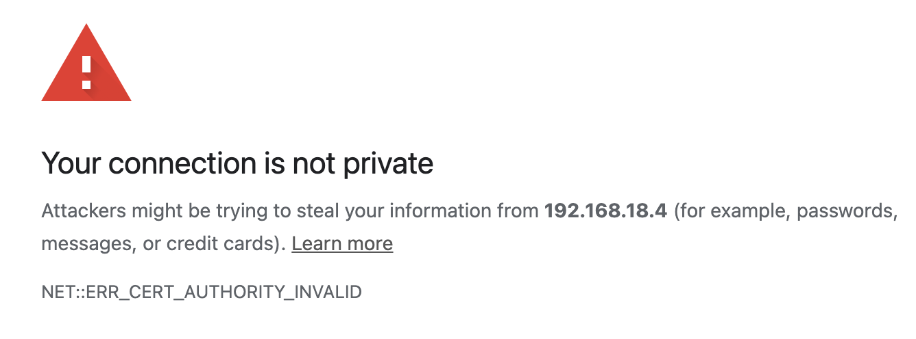
Threat Models: Web Server
Preventing the man-in-the-middle with SSL
HTTP Request
Encrypted request
HTTP Response
Encrypted response
client page
(the “user”)
server
amazon.com certificate
(AZ’s public key + CA’s sig)

Slide 17
SSL: A perfect solution?
Certificate authorities
A certificate authority (or CA) binds some public key to a real-world entity that we might be familiar with
The CA is the clearinghouse that verifies that amazon.com is truly amazon.com
CA creates a certificate that binds amazon.com's public key to the CA’s public key (signing it using the CA’s private key)

Slide 18
Certificate Authorities
Certificate Authority
Amazon
CA private key
CA private key
amazon.com certificate
(AZ’s public key + CA’s sig)
amazon.com private key
CA public key
My Laptop
amazon.com public key
amazon.com public key
Some real-world proof that we are really amazon.com
CA public key
amazon.com certificate
(AZ’s public key + CA’s sig)

Slide 19
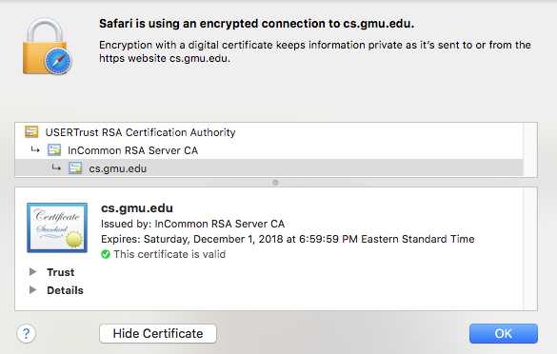
Certificate Authorities
Note: We had to already know the CA's public key
There are a small set of “root” CA’s (think: root DNS servers)
Every computer/browser is shipped with these root CA public keys

Slide 20
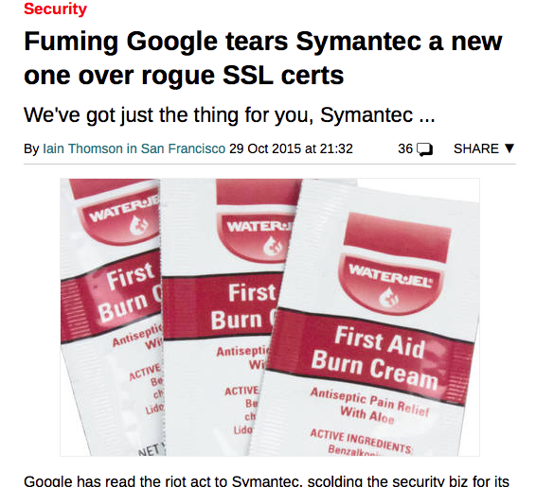
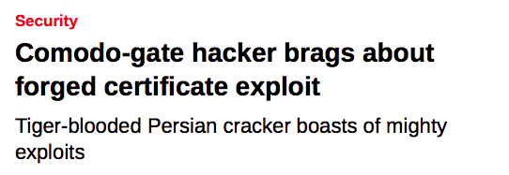
Certificate Authorities
Nation-state-scale attackers
What happens if a CA is compromised, and issues invalid certificates?
Not good times.

Slide 21
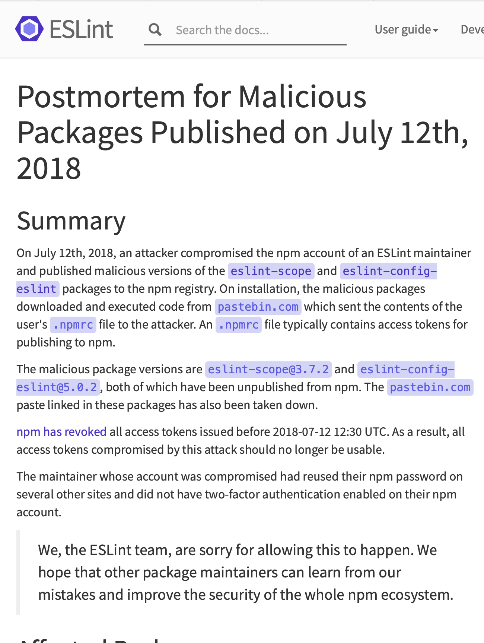
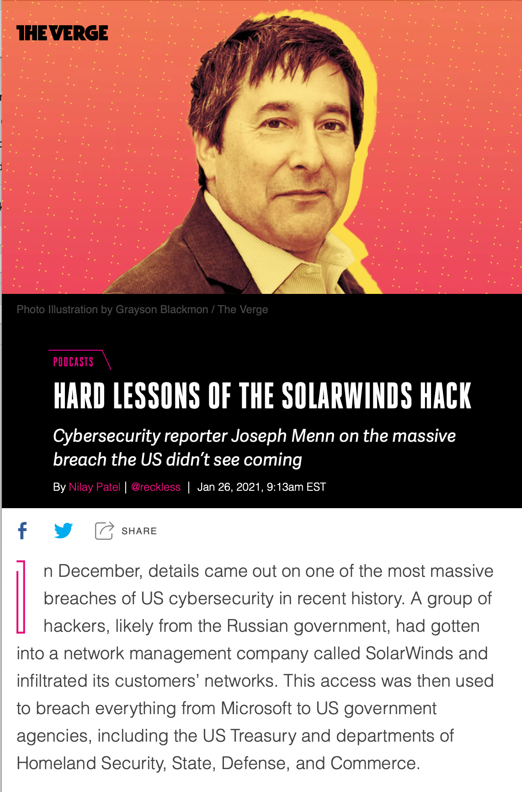
Dependencies and Development Environment
Do we trust our own code? Third-party code provides an attack vector
https://www.theverge.com/2021/1/26/22248631/solarwinds-hack-cybersecurity-us-menn-decoder-podcast
https://eslint.org/blog/2018/07/postmortem-for-malicious-package-publishes

Slide 22
Costs & Benefits
We can fix everything at a cost…
We can ensure our code is not tampered with by running all of it on our own machines (remove logic from frontend)
Increases latency
What if someone hacks into our server?
We can fix the certificate authority issue by securely distributing our own certificate (out of band)
Cumbersome
What if someone hacks into the client and replaces certificate?
Can we trust our own code? How?

Slide 23
Learning Objectives for this Lesson
By the end of this lesson, you should be able to…
Describe that security is a spectrum, and be able to define a realistic threat model for a given system
Evaluate the tradeoffs between security and performance in software engineering
Notes:
Next, will discuss specific vulnerabilities, and ways to mitigate them

Slide 24
This work is licensed under a Creative Commons Attribution-ShareAlike license
This work is licensed under the Creative Commons Attribution-ShareAlike 4.0 International License. To view a copy of this license, visit http://creativecommons.org/licenses/by-sa/4.0/
You are free to:
Share — copy and redistribute the material in any medium or format
Adapt — remix, transform, and build upon the material
for any purpose, even commercially.
Under the following terms:
Attribution — You must give appropriate credit, provide a link to the license, and indicate if changes were made. You may do so in any reasonable manner, but not in any way that suggests the licensor endorses you or your use.
ShareAlike — If you remix, transform, or build upon the material, you must distribute your contributions under the same license as the original.
No additional restrictions — You may not apply legal terms or technological measures that legally restrict others from doing anything the license permits.

